Slide 1
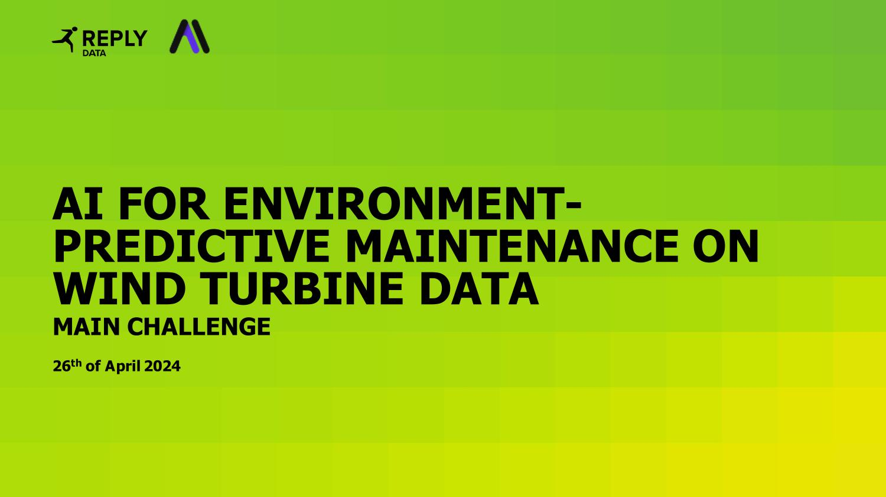

Slide 2
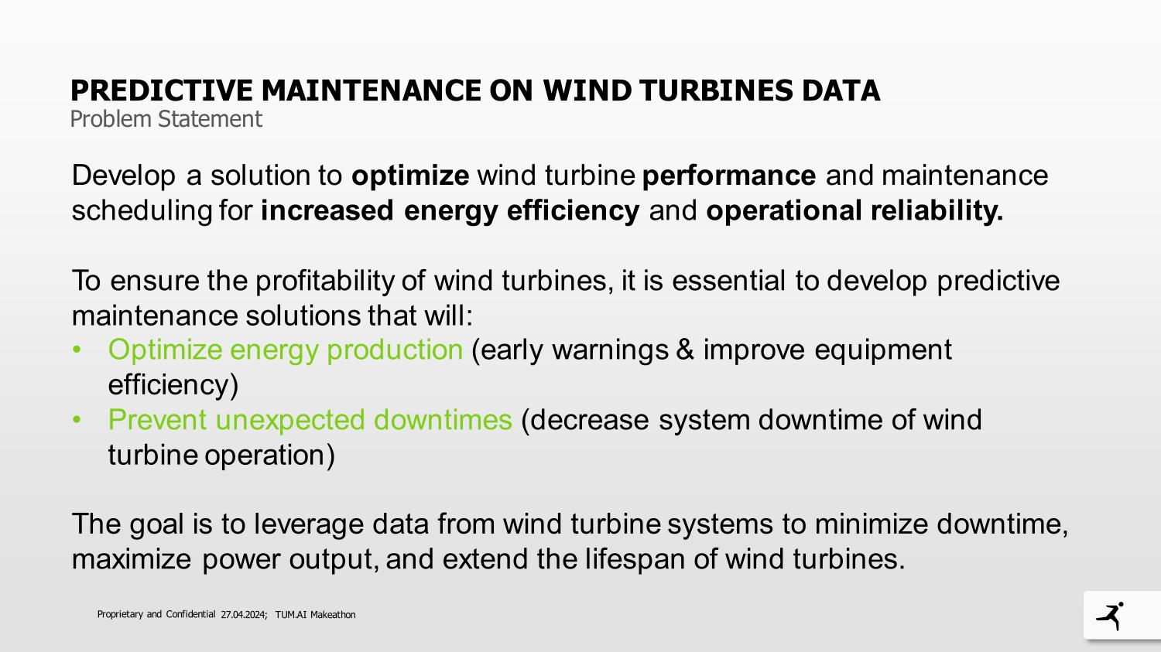

Slide 3
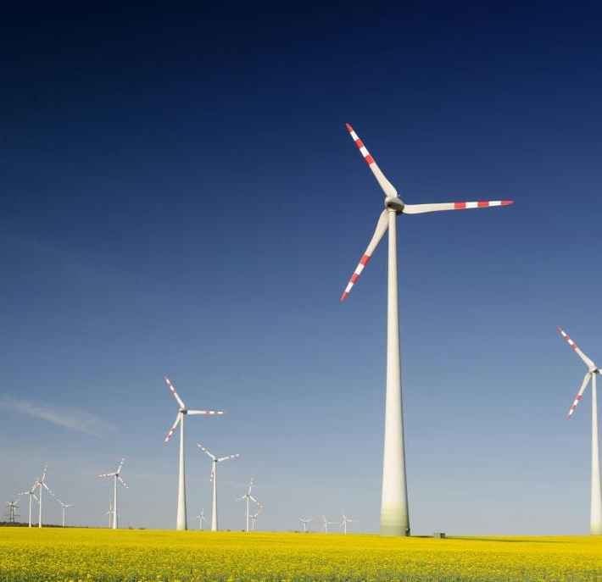
HOW DO YOU OPTIMIZE ENERGY PRODUCTION AND PREVENT UNEXPECTED DOWNTIMES?
Our solution:
Predict specific technical problems that caused the windmill to stop operating multiple times in the past.
These errors need to have some properties:
Need to happen frequently and idealy on all operating machines
Can be predicted from the data
Have to be preventable by maintanance work in advance (e.g. strong wind that causes reduced RPM is not relevant)
→Problem: The given dataset does not provide this information.
So we searched for our own dataset first: Penmanshiel Wind Farm Data (GB), Kelmarsh Wind Farm (GB) with 299 features and more than 1.7 mio. time stamps

Slide 4

HOW DO YOU OPTIMIZE ENERGY PRODUCTION AND PREVENT UNEXPECTED DOWNTIMES?
Understanding Failures frequency, predictability, and preventability, focused on frequency converter errors
Feature Reduction only less than 18% NaN, determine 48 relevant attributes
Error Data Analysis Quantified the occurrence of frequency converter errors and the associated downtime
Feature Data Analysis visual inspections to detect patterns and correlations
Visualization and Dimension Reduction with Umap Detected clusters, multiple counts of events per day
Data Cleaning / Insufficient Data for Reliable Predictions only 14 points available for predictive modeling.
Time Series Analysis intervals of 24, 48, and 72 hours before damage, aggregated features
Further Feature Reduction and Predictive Modeling feature importance metrics, logistic regression model
Model Testing developed model to the Penmanshiel, did not yield successful predictions, data limitations

Slide 5
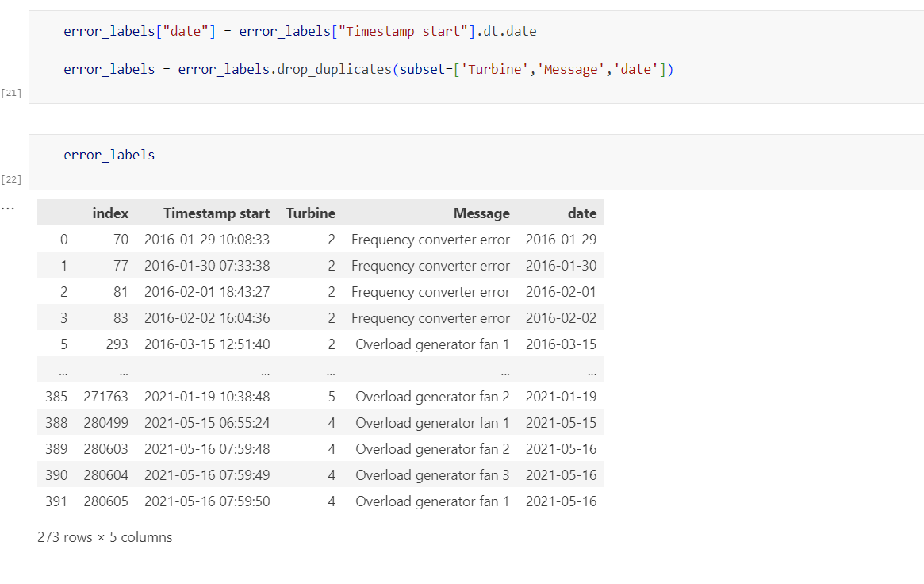
1.UNDERSTANDING FAILURES
focus on one error

Slide 6
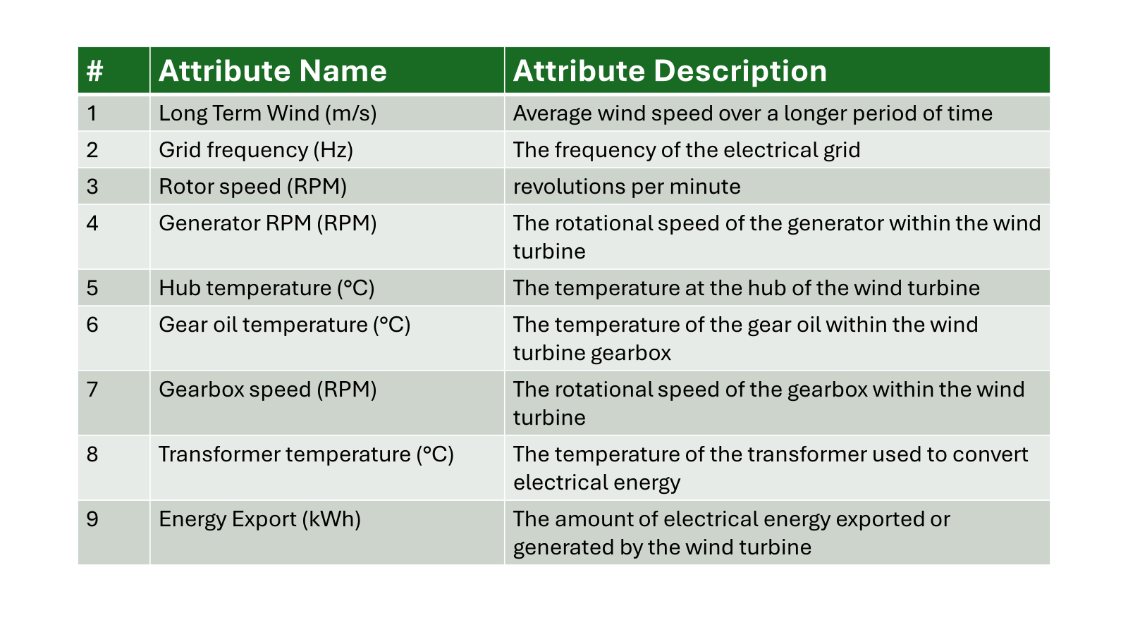
2.FEATURE REDUCTION

Slide 7
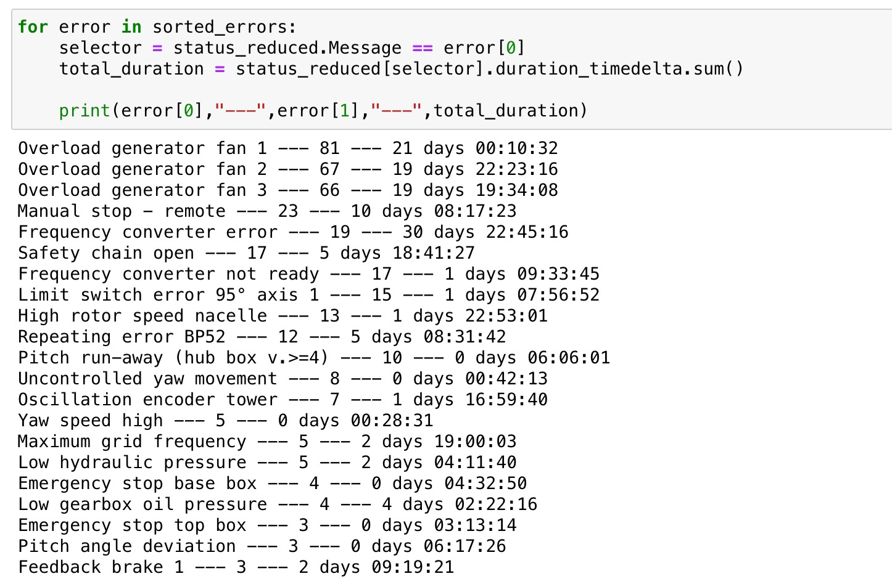
3.ERROR DATA ANALYSIS
more than 30 days of downtime on the data in Kelmarsh

Slide 8
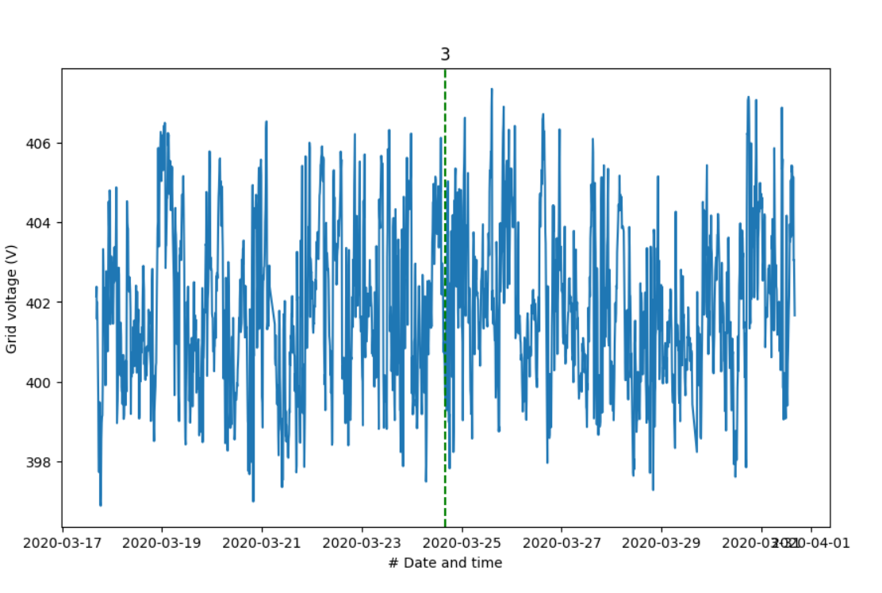
4.FEATURE DATA ANALYSIS

Slide 9
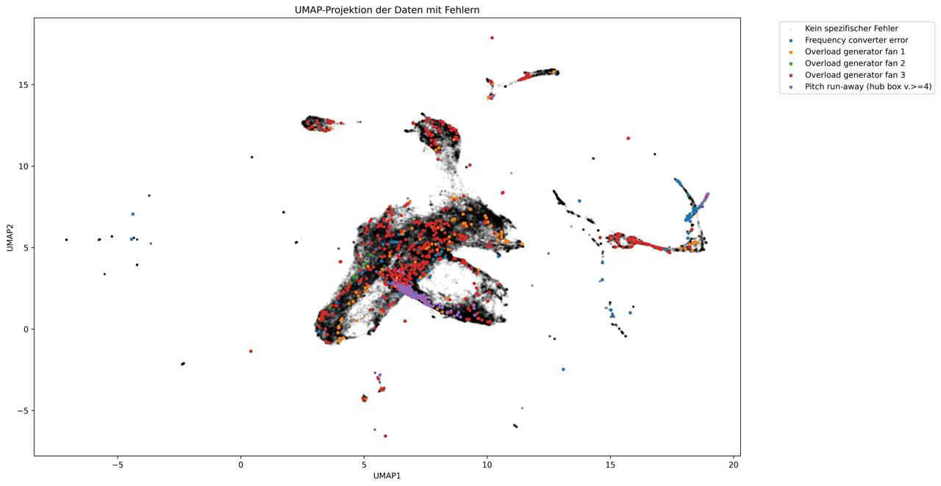
5. Visualization and Dimension Reduction with Umap

Slide 10
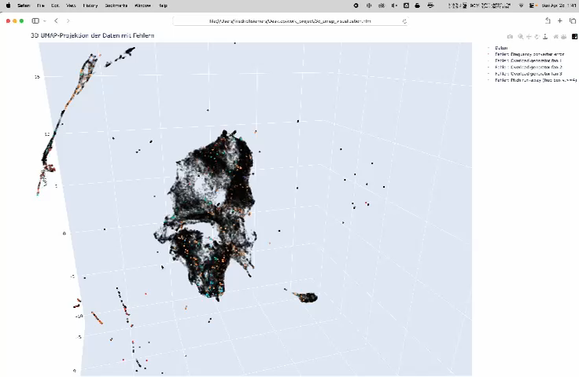

Slide 11
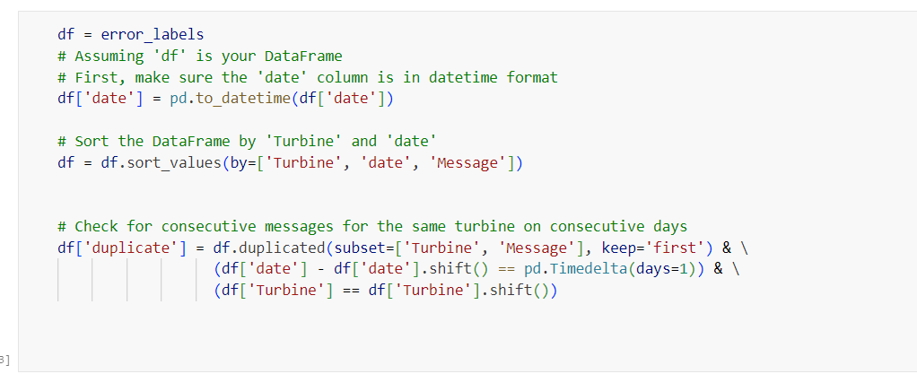
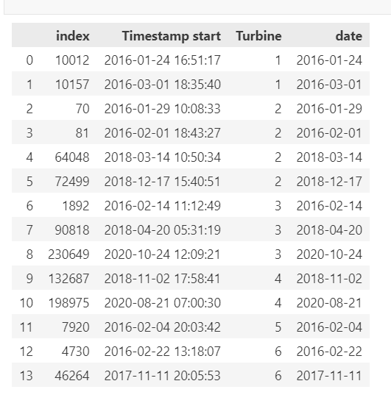
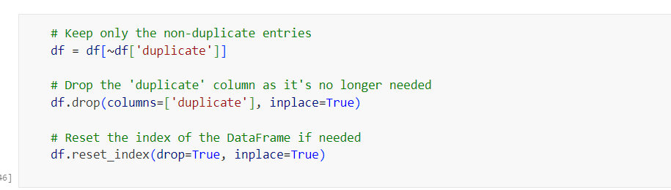
6.DATA CLEANING / INSUFFICIENT DATA FOR RELIABLE PREDICTIONS

Slide 12
7.Time Series Analysis intervals of 24, 48, and 72 hours before damage, aggregated features
8.Further Feature Reduction and Predictive Modeling feature importance metrics, logistic regression model

Slide 13
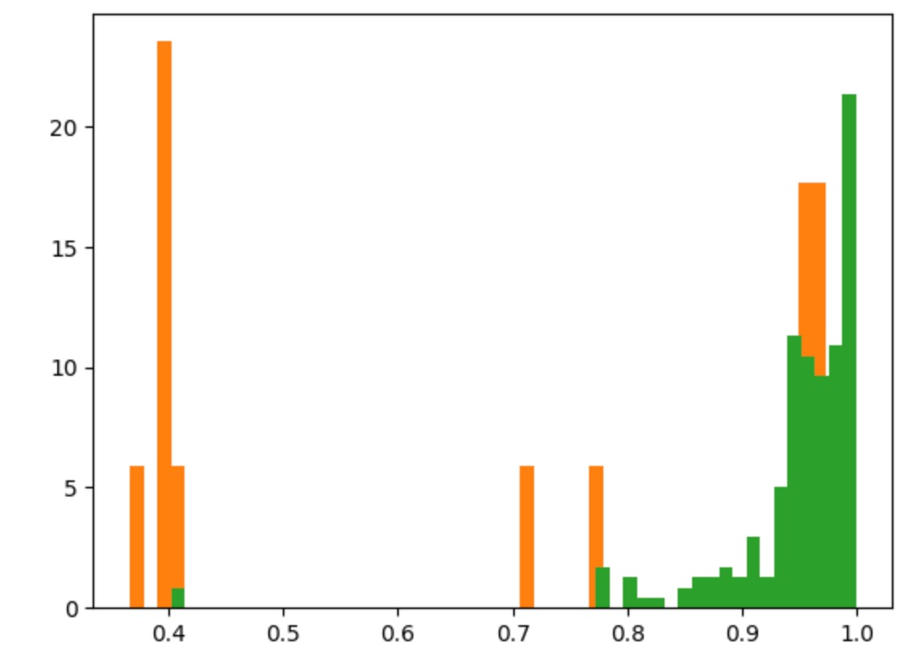
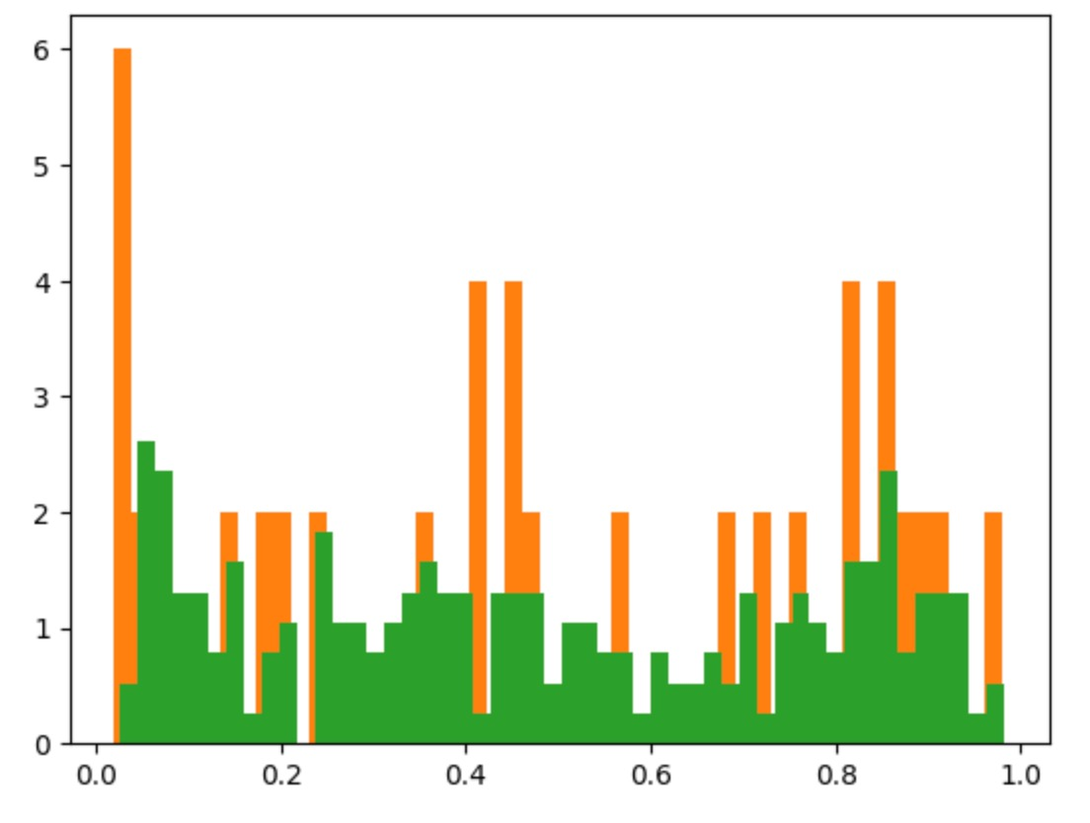
9.MODEL TESTING
density points with failure (orange) without failure (green)
density points with failure (orange) without failure (green)
predicted probability of no failure
predicted probability of no failure
Kelmarsh Wind Farm training data
Penmanshiel Wind Farm test data
did not yield successful predictions due to data limitations

Slide 14
FUTURE DIRECTIONS
Expand data collection efforts to include a wider array of error types and operational conditions.
Explore more advanced machine learning algorithms that can handle sparse data more effectively.

Slide 15


Slide 16


CONTACT
Phillip Wondra:
www.linkedin.com/in/philipp-wondra-76552719b
Maximilian Seeger
Benedikt Kellner
Friedrich Siemers
DATA SOURCE:
https://zenodo.org/records/5841834#.YgpBQ_so-V7
https://zenodo.org/records/5946808#.YgpAmvso-V5
www.kimpact.de

